Slide 1
Skin Disease Detection, its Severity Classification and Treatment Recommendation System
Developed a Deep Learning Model for Classifying Skin Diseases And Treatment Recamendation.

Slide 2
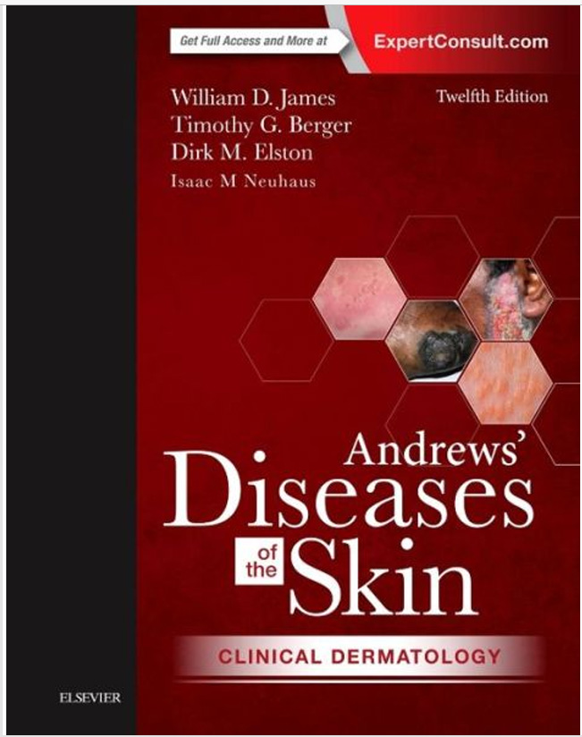
Introduction
This presentation outlines the development of a deep learning model designed to classify various skin diseases based on images and Treatment Recommendation of that disease. The model utilizes a dataset of 10 skin disease classes, focusing on techniques in preprocessing, model training, and web application and for Recommendation, the chatbot uses book name Andrews-Diseases-of-the-Skin-Clinical-Dermatology.

Slide 3
01
Model Development
Trained the model using EfficientNetB3, achieving 93% accuracy on the training set.
Applied dropout and batch normalization to improve generalization.
Used data augmentation to enhance model robustness.
Implemented early stopping to prevent excessive training.
Fine-tuned hyperparameters for better validation performance.
Integrated Gemini 2.0 Flash as an LLM-powered chatbot for interactive treatment recommendations.
The chatbot provides real-time medical guidance, using book name Andrews' Diseases of the Skin as a reference.
Ensured chatbot responses are accurate, context-aware, and aligned with dermatological best practices.
Saved the trained model and chatbot system for further optimization and deployment.

Slide 4
Dataset Overview
Used a dataset containing 10 distinct classes of skin diseases, ensuring a diverse and comprehensive training set for effective image classification. This variety enhances the model’s ability to recognize different skin conditions, improving its clinical utility in dermatology. Additionally, for treatment recommendations and chatbot interactions, I utilized the book Andrews' Diseases of the Skin: Clinical Dermatology as a reference to provide accurate and reliable medical guidance

Slide 5
Model Selection and Architecture
For image classification, we selected EfficientNetB3, a state-of-the-art deep learning model known for its efficiency, accuracy, and scalability in computer vision tasks.
EfficientNetB3 was chosen due to its better performance with fewer parameters, making it ideal for skin disease detection with high accuracy.
For treatment recommendation and chatbot functionality, we integrated Gemini 2.0 Flash, a powerful LLM designed for fast and contextually accurate responses in medical dialogue.

Slide 6
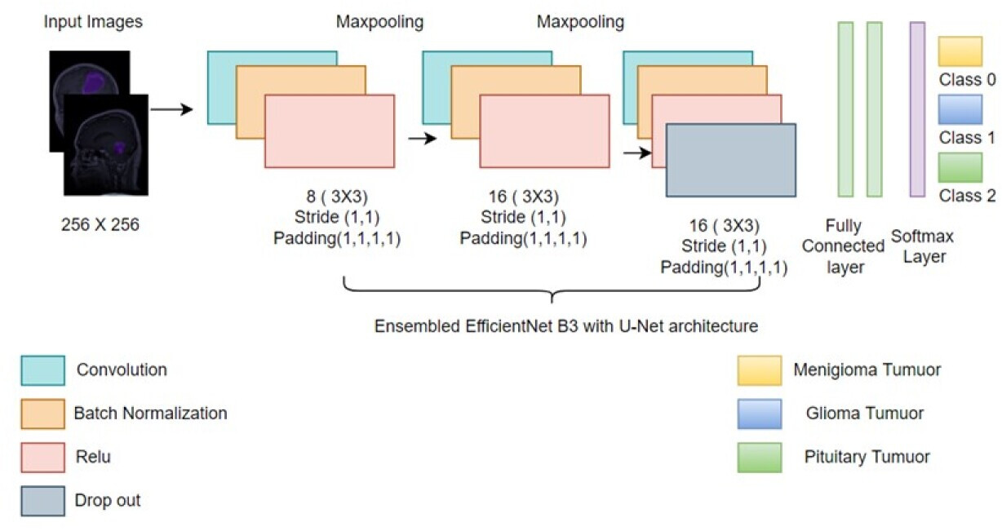







Slide 7
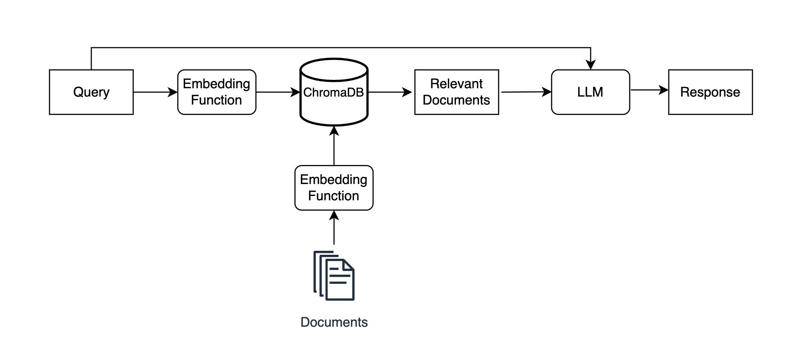
RAG Architecture

Slide 8
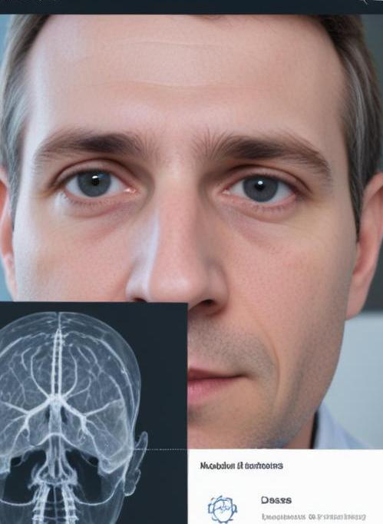
Web Application Functionality
A Flask-based web application was developed to facilitate user interaction with the model. Users can upload skin images, and the application processes these inputs, providing predictions on skin diseases along with confidence scores. This impactful functionality makes the technology accessible to both dermatologists and patients seeking quick evaluations.

Slide 9
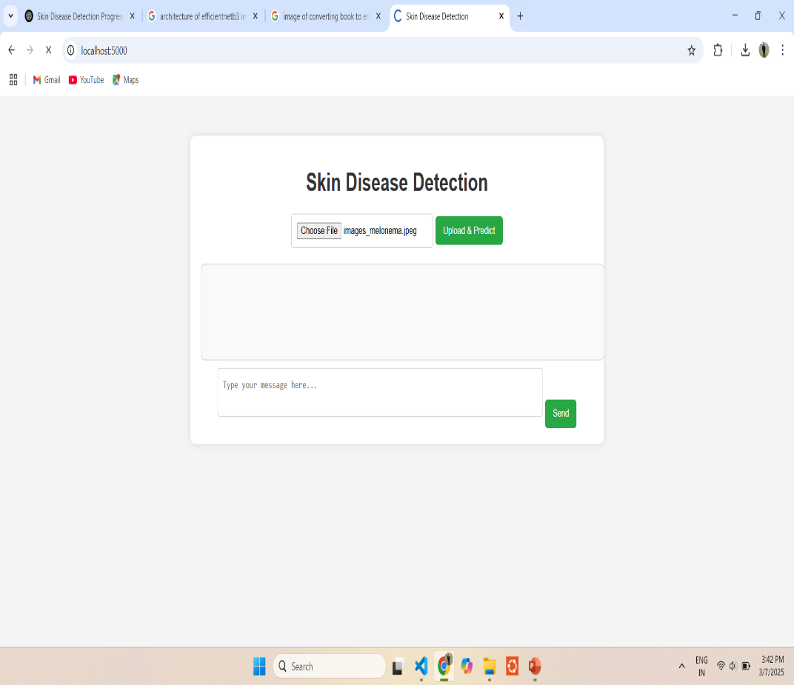
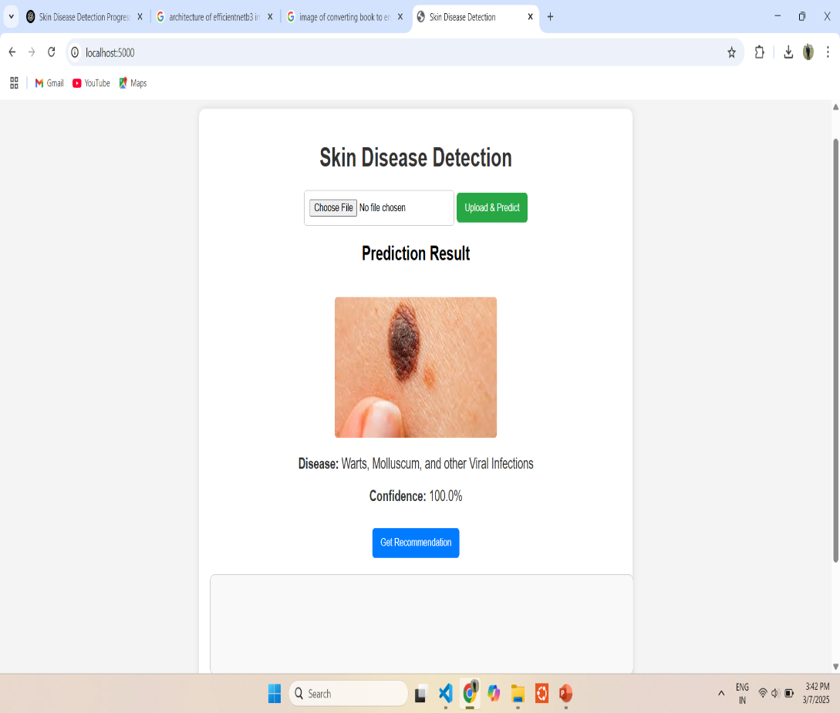
02
Results

Slide 10
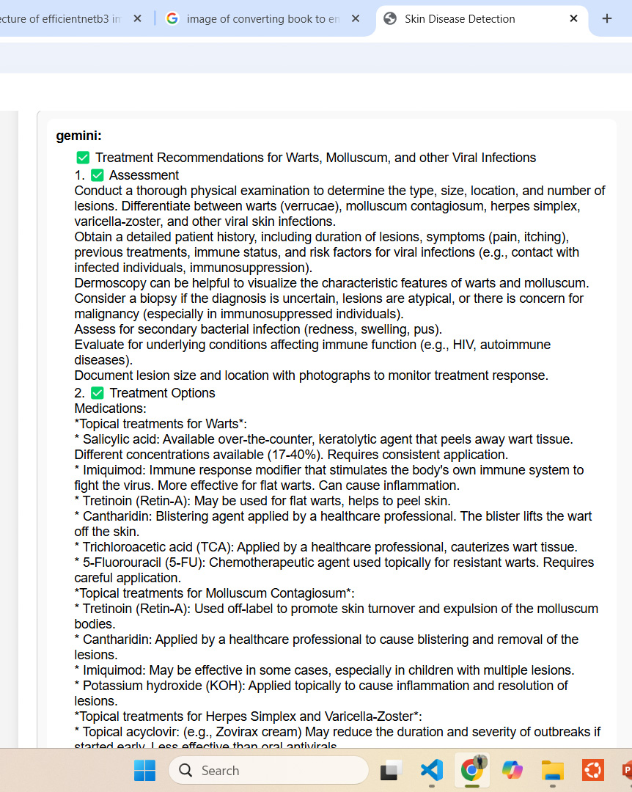
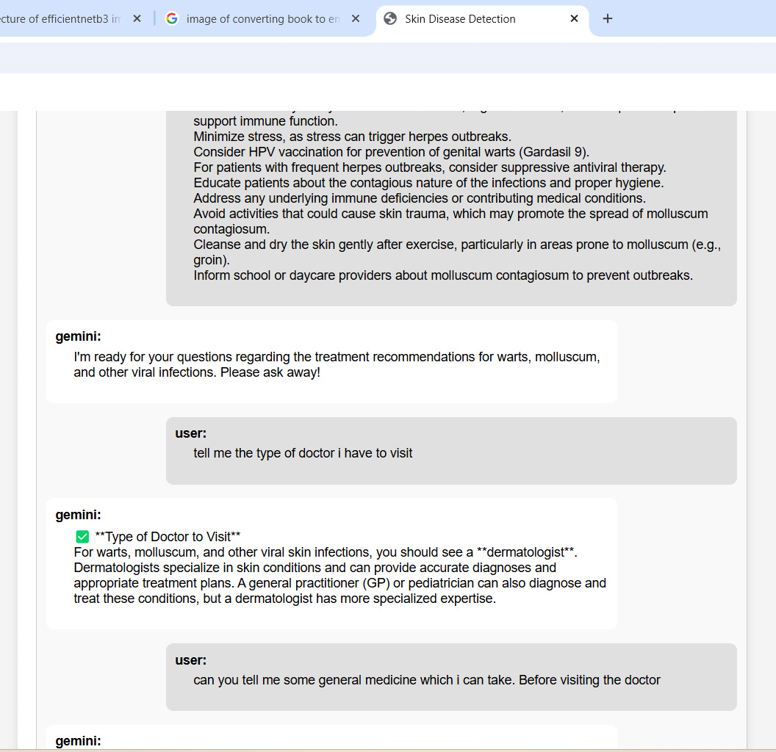

Slide 11
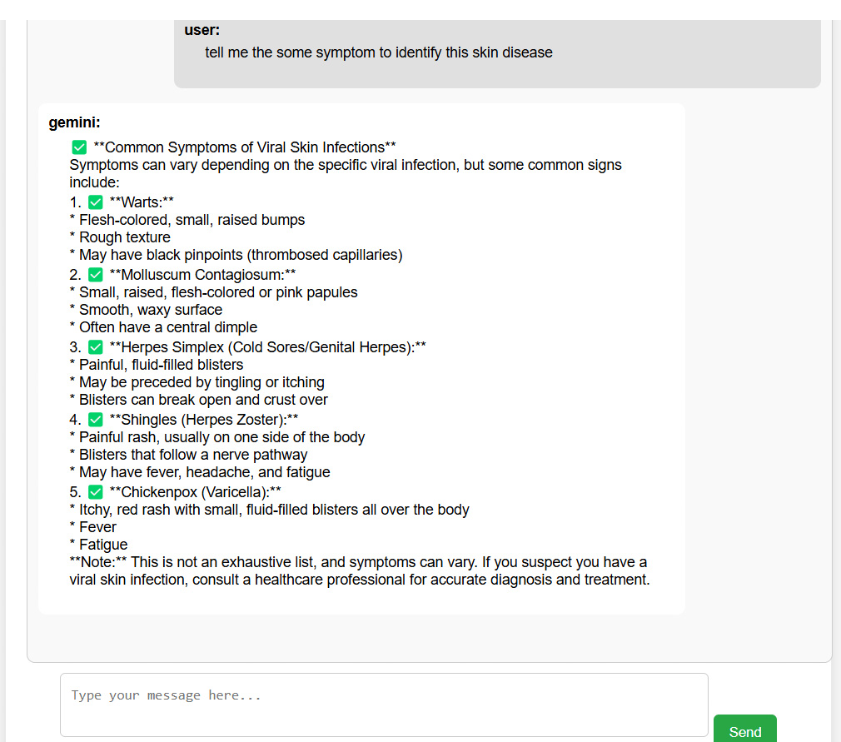

Slide 12
Future Work
Implement Severity Classification System
Develop a model to classify skin diseases into severity levels (Mild, Moderate, Severe).
Fine-tune the existing EfficientNetB3 model to predict both disease type and severity.
Explore multi-task learning to jointly train disease classification and severity detection.
Improve Model Accuracy
Enhance the model by experimenting with larger architectures (EfficientNetV2, Vision Transformers).
Apply advanced regularization techniques like label smoothing and stochastic depth to prevent overfitting.
Optimize hyperparameters using grid search or Bayesian optimization.
Use ensemble learning by combining predictions from multiple models to improve robustness.
Enhance Data Quality & Augmentation
Increase dataset diversity by incorporating additional dermatology datasets.
Improve data augmentation techniques specific to skin images (e.g., histogram equalization, adaptive contrast enhancement).
Address class imbalance using synthetic data generation or weighted loss functions.
Optimize Chatbot & Recommendation System
Fine-tune the Gemini 2.0 Flash LLM for better medical recommendations.
Improve FAISS retrieval accuracy by integrating hybrid search techniques.
Implement interactive chatbot features, allowing users to refine queries for better treatment advice.

Slide 13
Conclusions
The development of this deep learning-based Skin Disease Detection, Severity Classification, and Treatment Recommendation System marks a significant advancement in AI-assisted dermatology. By leveraging EfficientNetB3 for disease classification and Gemini 2.0 Flash for intelligent recommendations, the system provides quick, accurate, and reliable diagnoses to assist healthcare professionals.
The integration of a chatbot-driven recommendation system further enhances user interaction, enabling personalized treatment guidance based on medical literature. Despite challenges such as overfitting and model optimization, continuous refinements have led to improved performance and usability.
With further improvements in severity classification, accuracy optimization, and user customization, this system has the potential to become a powerful AI-driven tool in dermatology, bridging the gap between technology and real-world medical applications.

Slide 14
Thank you!
Do you have any questions?

